Slide 1

BIM - ISO 19650 Overview and Implementation
Paul Vesey

Slide 2
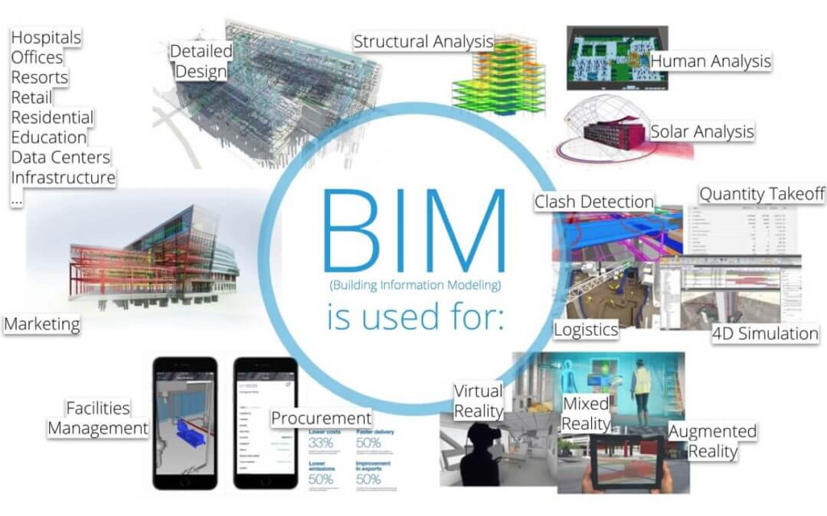
BIM - Process or Technology?
BIM is a Technology Enabled Process

Slide 3

Building Blocks of BIM
Building Data
Design & Specification
Construction Process & Methodologies
Communications
Digital, Analogue, Interpersonal

Slide 4
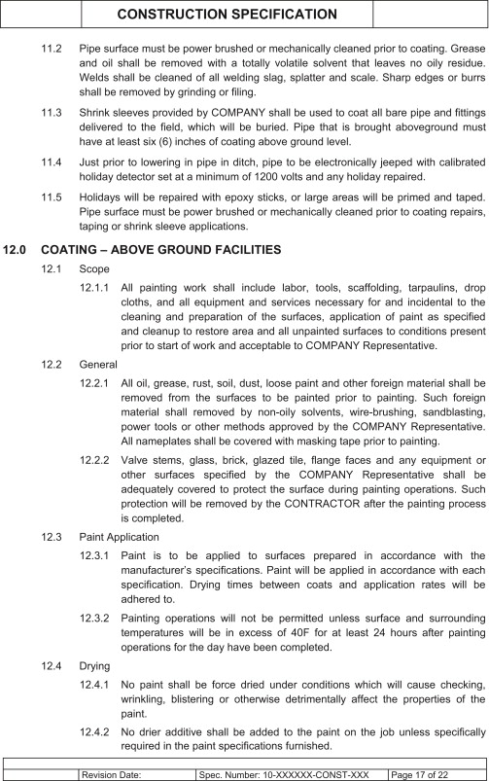
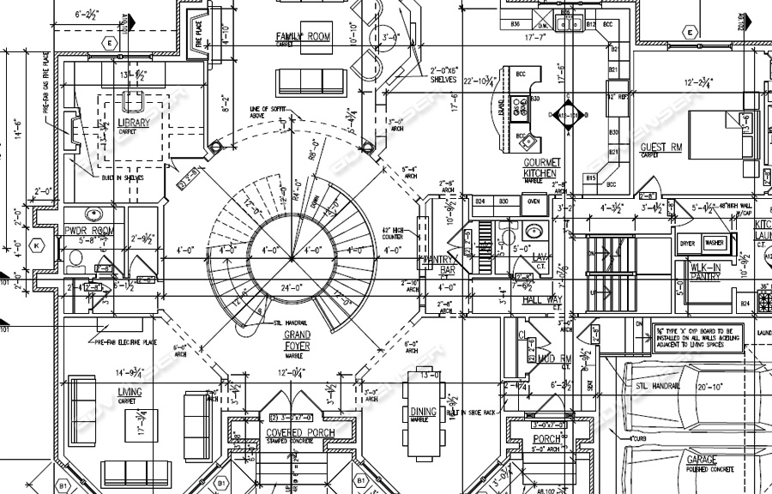
Building Design & Specification
Well Established

Slide 5

Construction Processes
Well known and understood, but continually evolving

Slide 6
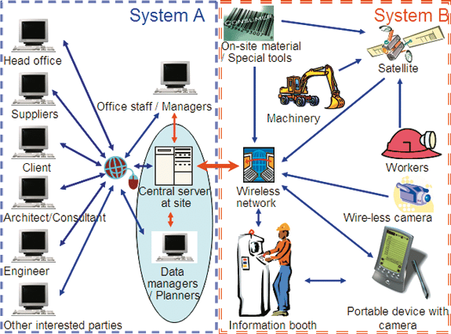
Communications
Remain problematic
Many actors
Differing technologies
Information Locations
Information Latency

Slide 7
Construction Inefficiency
Deficient Planning
Design Error & Change
Communication Latency
Poor On-site Productivity & Task Tracking
Etc.

Slide 8

How does BIM help?
Fundamental Concepts from Manufacturing Sector
Highly detailed digital models of the built asset

Slide 9
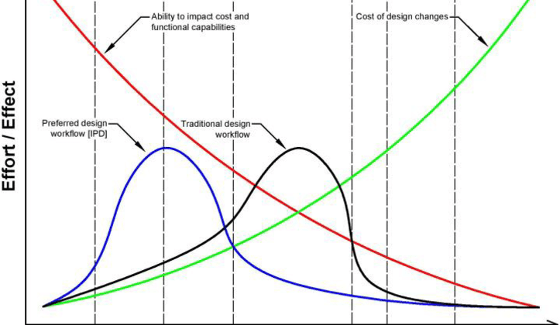
Why is BIM Necessary?
Designs Resolved Earlier
Manufacturability (Constructability) addressed earlier
Better understanding of the design by all parties

Slide 10
Key Features of BIM Process
Detailed Documentation earlier in the project
Clash Detection carried out on Digital Models
Support Activities can be modelled earlier
Material Supply, Storage and Movement
Formwork
Health & Safety

Slide 11
How to Utilize BIM
Not Possible without Management Planning
Technology is not enough
Detailed Processes needed for BIM management and control

Slide 12
Key Features of BIM Project Delivery
Common Data Environment (CDE)
Clear Understanding of the Client (Building Owner) Requirements for both the Build Project and Asset Management post construction
Client must clearly define their information needs before the project starts
Supply Chain Must understand their part in ensuring the project meets both the Asset Requirements and the Information Requirements
ISO19650 seeks to create a framework for these needs to be met

Slide 13

ISO 19650
International Organization for Standardization
ISO19650 is a Global standard
Roots in the UK PAS/BS 1192 Standards
ISO19650- Organization and digitization of information about buildings and civil engineering works, including building information modelling (BIM) — Information management using building information modelling
The standard is organized into several interdependent parts
ISO 19650-1:2018 — Part 1: Concepts and principles
ISO 19650-2:2018 — Part 2: Delivery phase of the assets
ISO 19650-3:2020 — Part 3: Operational phase of the assets
ISO 19650-5:2020 — Part 5: Security-minded approach to information management

Slide 14
ISO 19650
The standards are not independent
They do not follow in sequence
Part 4 – Information Exchange is under development
PAS1192 Part 4 (COBie) is available
Part 6 – Health & Safety unknown at this time
PAS1192 Part 6 is available

Slide 15
ISO 19650
This lecture will focus on:
ISO 19650-1:2018 — Part 1: Concepts and principles
ISO 19650-2:2018 — Part 2: Delivery phase of the assets
ISO 19650-3:2020 — Part 3: Operational phase of the assets

Slide 16
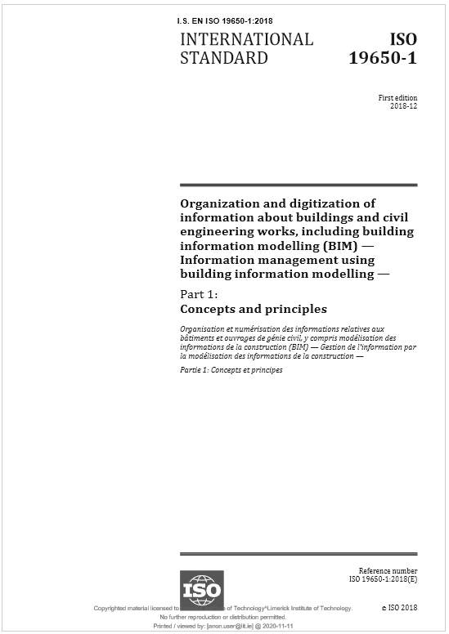
ISO 19650 — Part 1: Concepts and principles
Presents a framework for a common understanding
Defines the components of a BIM enabled project delivery platform
Defines some of the key tasks and undertakings of the Client, Main Contractor and Sub-contractors

Slide 17
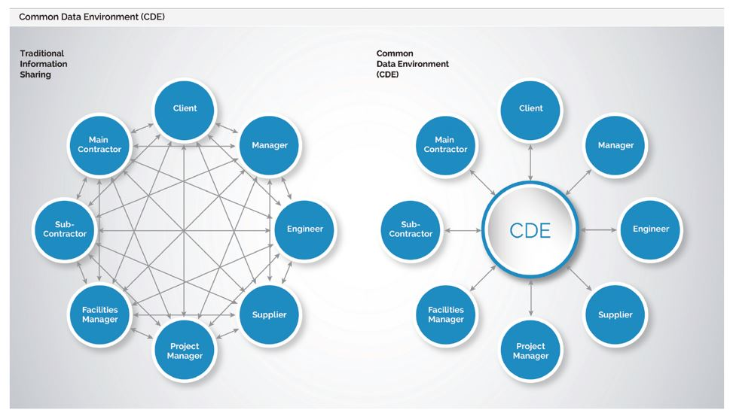
Key Terms: Common Data Environment (CDE)
https://bimportal.scottishfuturestrust.org.uk/level2/stage/1/task/2/determine-the-info-management-cde-strategy

Slide 18
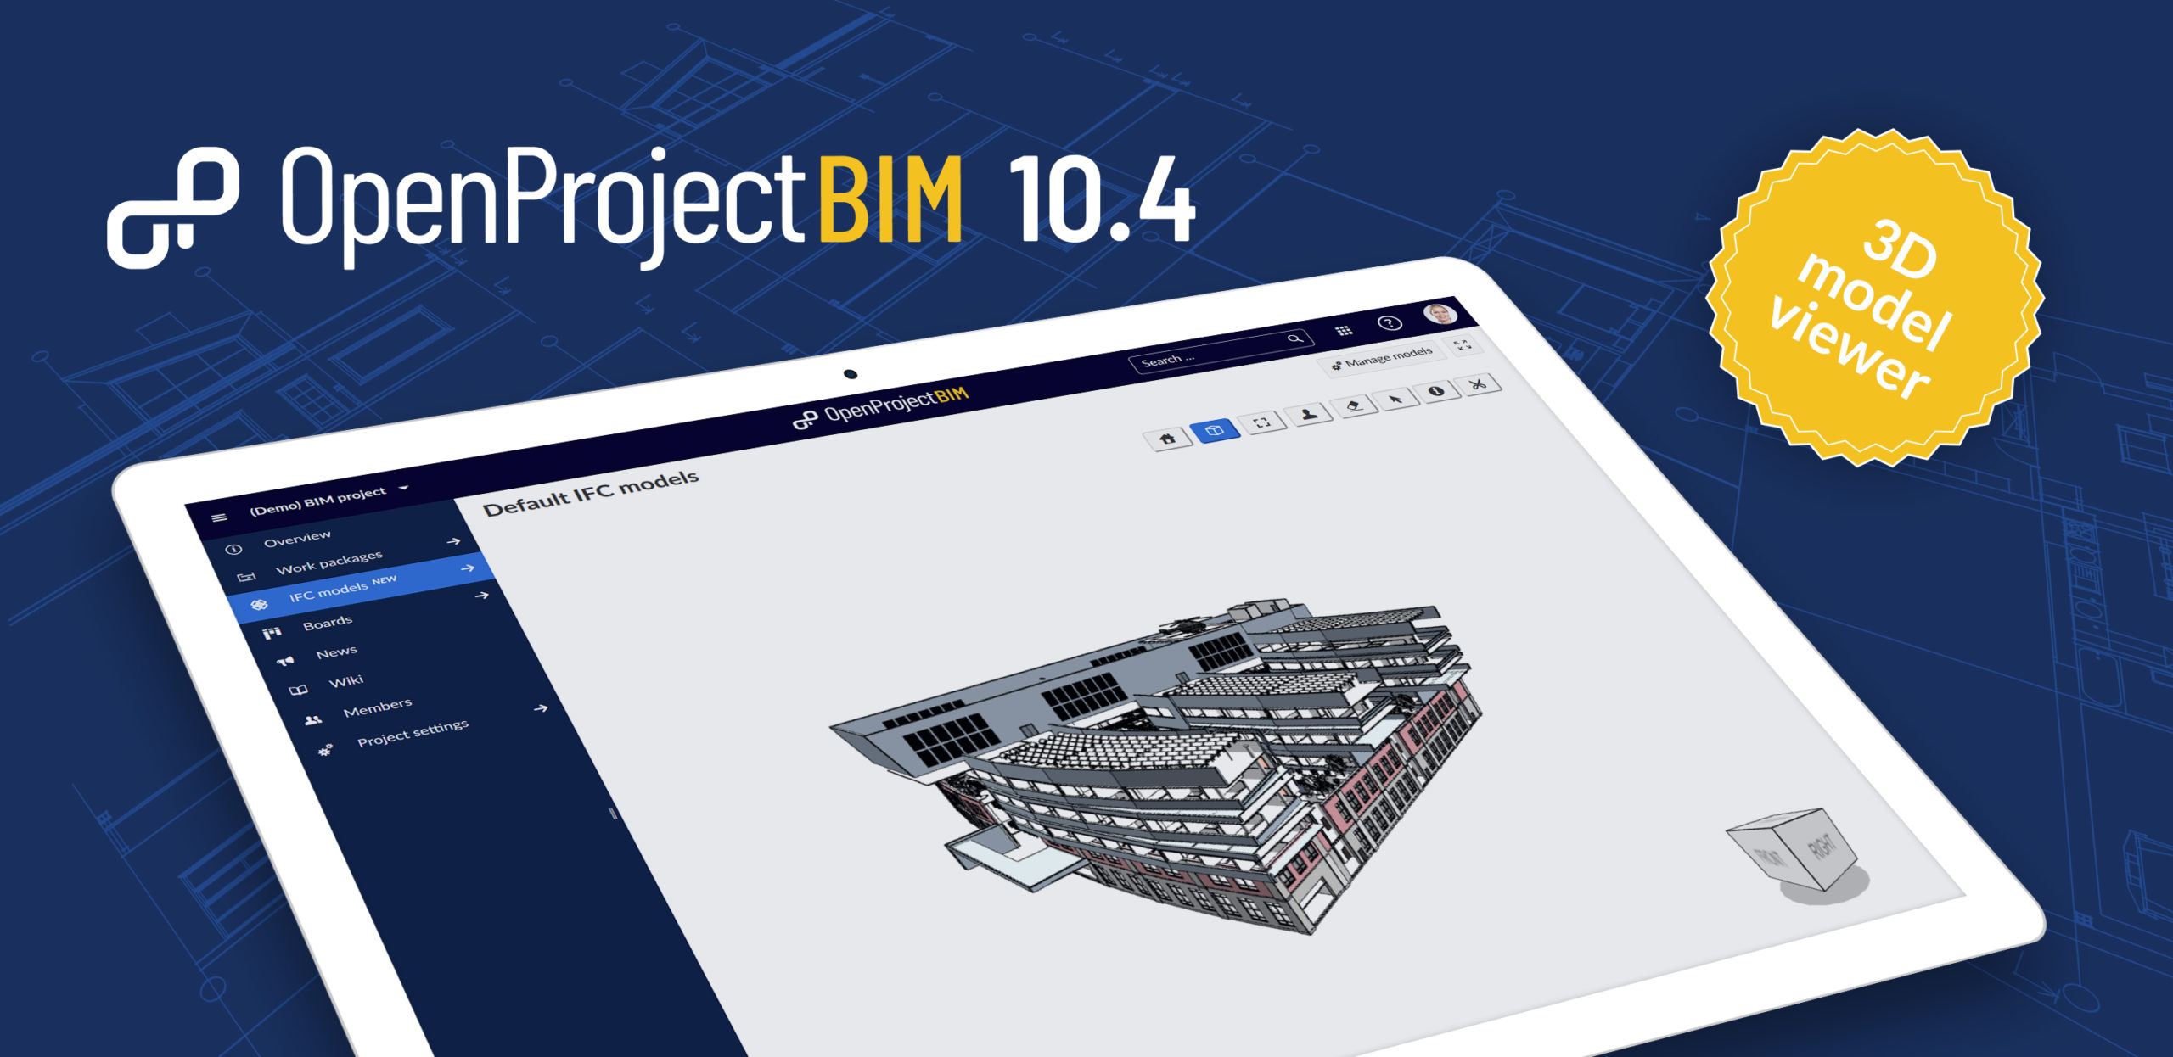
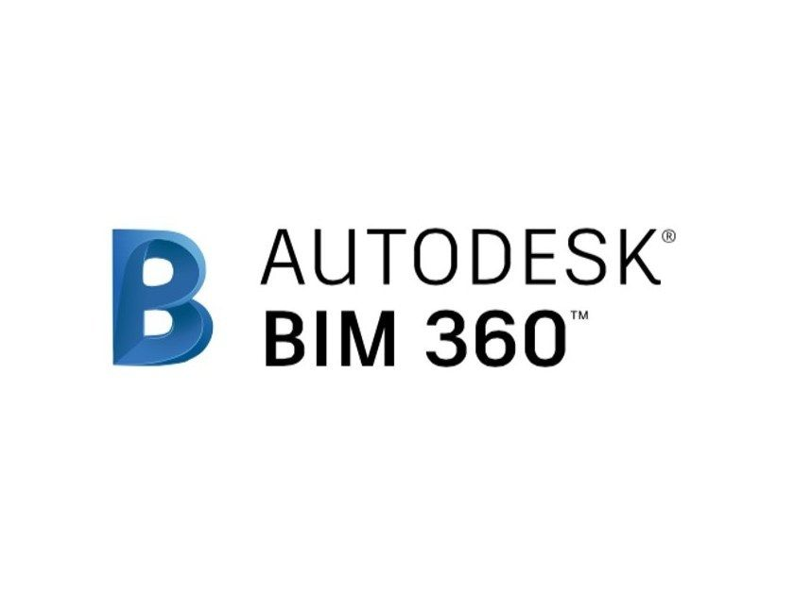

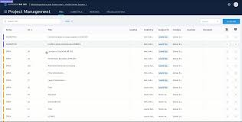
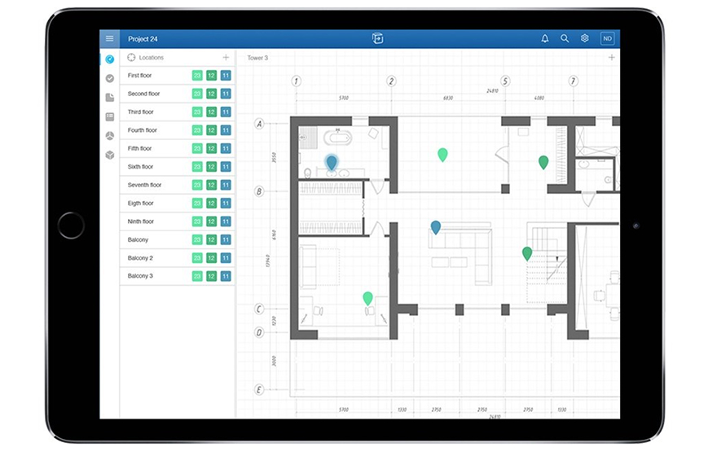
CDE Examples:

Slide 19
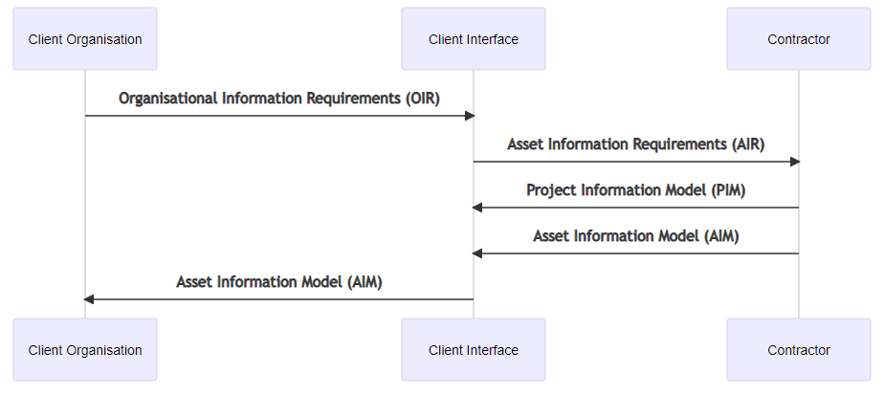
Document Workflow

Slide 20
Key Terms: Organizational Information Requirements (OIR)
OIR explain the information needed to answer or inform high-level strategic objectives within the appointing party. These requirements can arise for a variety of reasons, including:
strategic business operation
strategic asset management
portfolio planning
regulatory duties or
policy-making.
OIR can exist for reasons other than asset management, for example in relation to submitting annual financial accounts. These OIR are not considered further in this document.
Produced by the Client/Employer

Slide 21
Key Terms: Asset Information Requirements (AIR)
AIR set out managerial, commercial and technical aspects of producing asset information. The managerial and commercial aspects should include the information standard and the production methods and procedures to be implemented by the delivery team.
The technical aspects of the AIR specify those detailed pieces of information needed to answer the asset-related OIR. These requirements should be expressed in such a way that they can be incorporated into asset management appointments to support organizational decision-making.
A set of AIR should be prepared in response to each trigger event during asset operation and where appropriate should also refer to security requirements.
Where there is a supply chain, the AIR received by a lead appointed party can be sub-divided and passed on in any of its own appointments. AIR received by a lead appointed party can be augmented with its own information requirements.
Across an asset management strategy and plan there can exist several different appointments. The AIR from all these should form a single coherent and coordinated set of information requirements, sufficient to address all the asset-related OIR.
Initially produced by the Employer or a Consultant, on behalf of the Employer
Then produced by the Main Contractor for Subcontractors to respond to.

Slide 22
Key Terms: Project Information Requirements (PIR)
PIR explain the information needed to answer or inform high-level strategic objectives within the appointing party in relation to a particular built asset project. PIR are identified from both the project management process and the asset management process.
A set of information requirements should be prepared for each of the appointing party’s key decision points during the project.
Repeat clients may develop a generic set of PIR that can be adopted, with or without amendment, on all of their projects.
Produced by the Employer, contains project performance information, such as progress reports, project financial information, completion dates, as well as asset information.

Slide 23
Key Terms: Exchange Information Requirements (EIR)
EIR set out managerial, commercial and technical aspects of producing project information. The managerial and commercial aspects should include the information standard and the production methods and procedures to be implemented by the delivery team.
The technical aspects of the EIR should specify those detailed pieces of information needed to answer the PIR. These requirements should be expressed in such a way that they can be incorporated into project-related appointments. EIR should normally align with trigger events representing the completion of some or all project stages.
EIR should be identified wherever appointments are being established. In particular, EIR received by a lead appointed party can be sub-divided and passed on in any of its own appointments, and so on along the supply chain. EIR received by appointed parties, including lead appointed parties, can be augmented with their own EIR. Some of the EIR can be passed to their own appointed parties, particularly where information exchange within a delivery team is necessary and this information is not to be exchanged with the appointing party.
Across a project there can exist several different appointments. The EIR from all these appointments should form a single coherent and coordinated set of information requirements, sufficient to address all the PIR.
Produced by the employer, the EIR establishes the technical criteria for Project and Asset information to be transmitted.

Slide 24
Key Terms: Asset Information Model (AIM)
The AIM supports the strategic and day-to-day asset management processes established by the appointing party. It can also provide information at the start of the project delivery process. For example, the AIM can contain equipment registers, cumulative maintenance costs, records of installation and maintenance dates, property ownership details and other details that the appointing party regards as valuable and wishes to manage in a systematic way.
Produced by the Main Contractor in response to the Asset Information Requirements (AIR). Format of the data in accordance with the Exchange Information Requirements (EIR)

Slide 25
Key Terms: Project Information Model (PIM)
The PIM supports the delivery of the project and contributes to the AIM to support asset management activities. The PIM should also be stored to provide a long-term archive of the project and for auditing purposes. For example, the PIM can contain details of project geometry, location of equipment, performance requirements during project design, method of construction, scheduling, costing and details of installed systems, components and equipment, including maintenance requirements, during project construction.
Produced by the Main contractor with contributions from sub-contractors; best known as the Building Model.

Slide 26
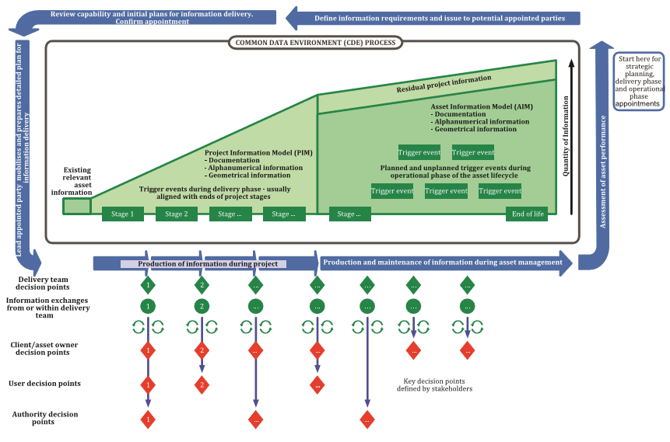
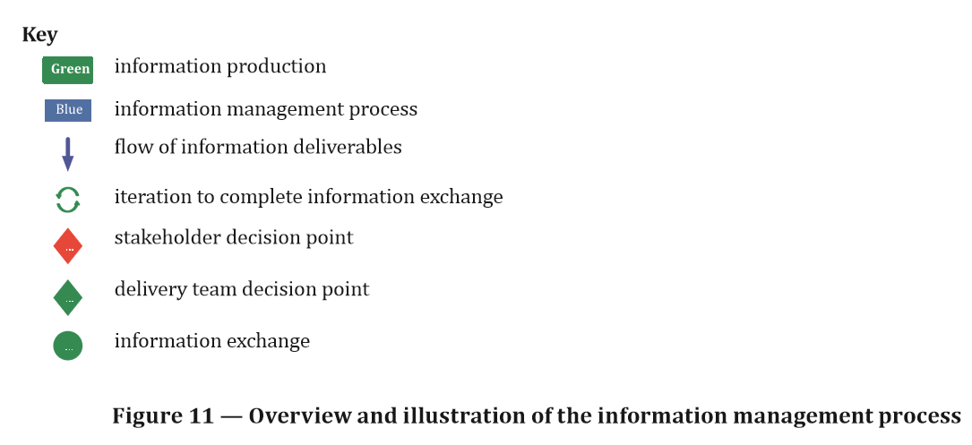

Slide 27
ISO 19650 — Part 1: Concepts and principles
Presents a framework for a common understanding
Defines the components of a BIM enabled project delivery platform
Defines some of the key tasks and undertakings of the Client, Main Contractor and Sub-contractors

Slide 28
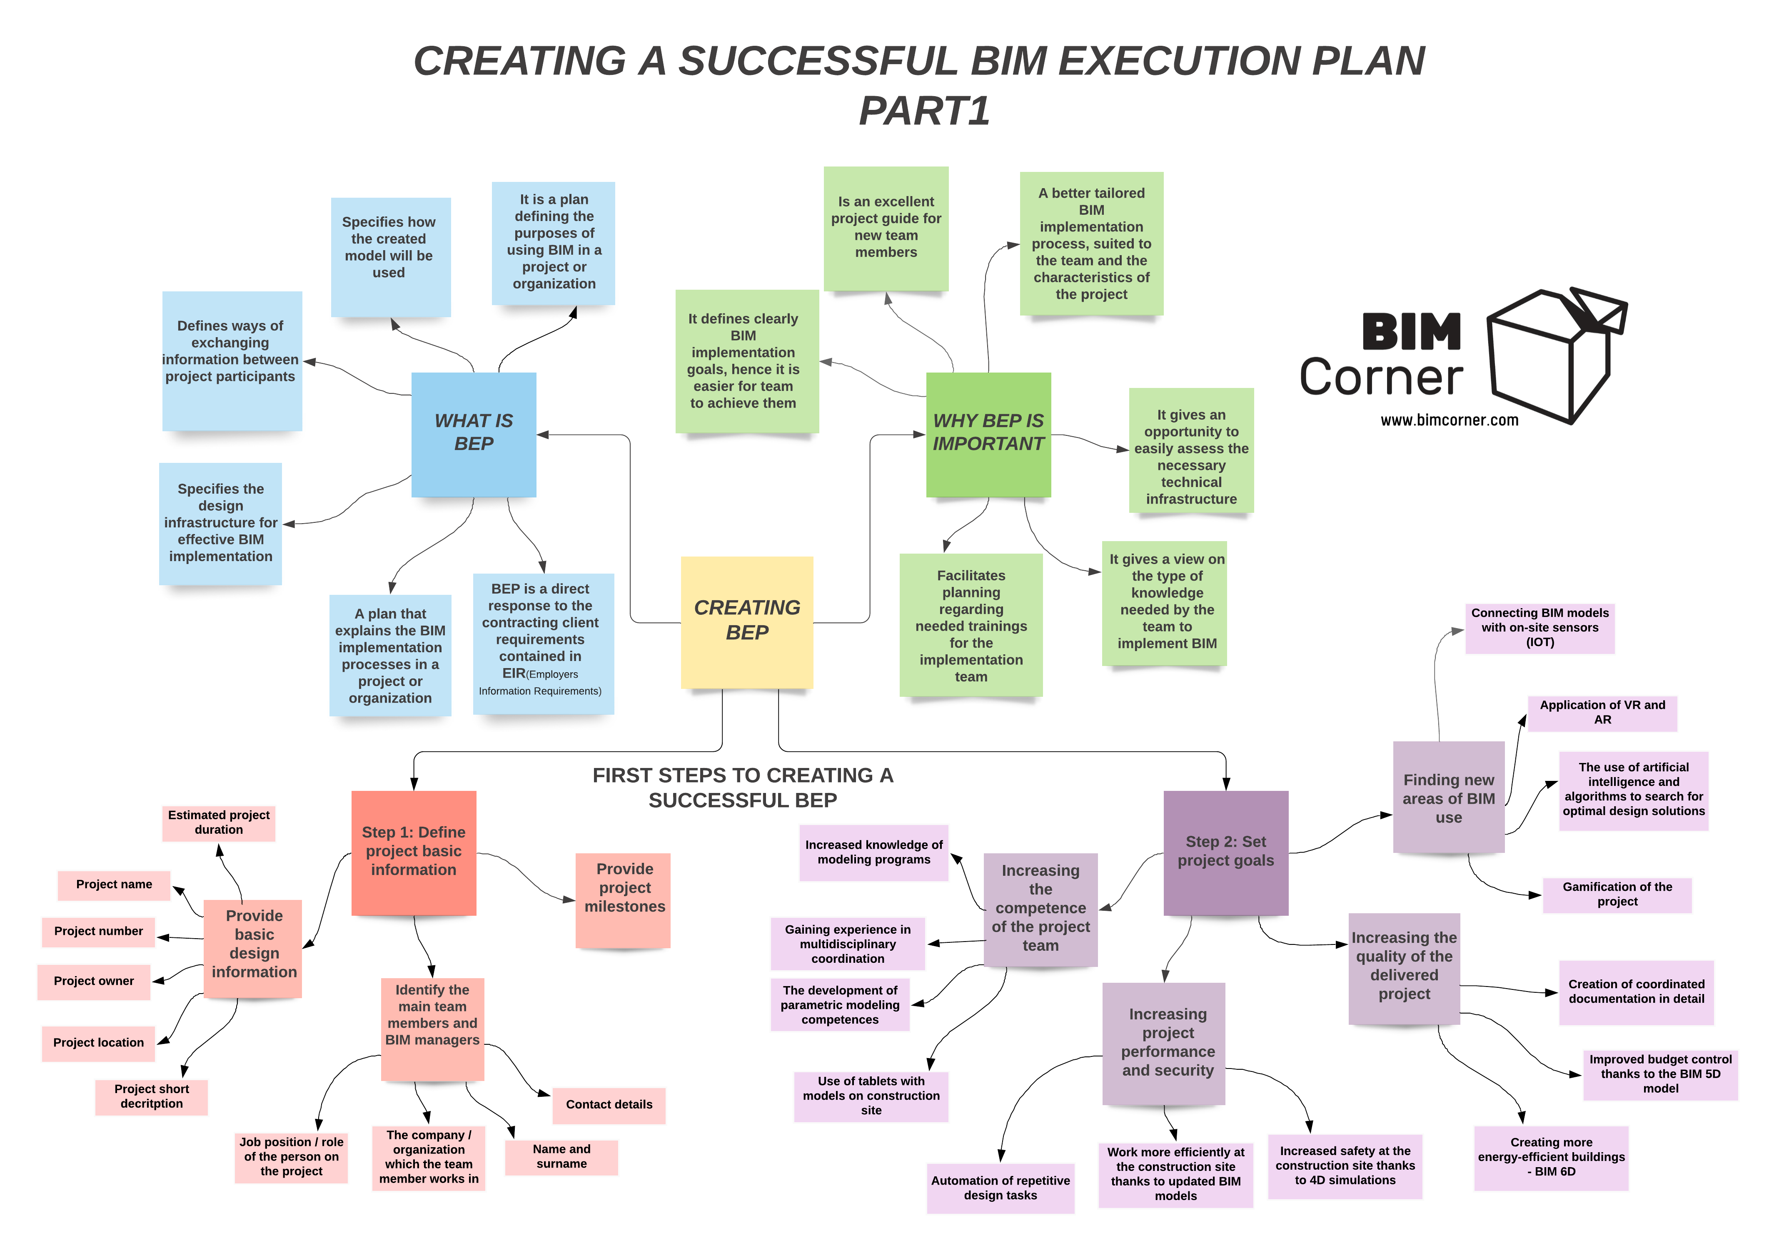
Key Terms – BIM execution plan (BEP)
plan that explains how the information management aspects of the appointment will be carried out by the delivery team
https://bimcorner.com/creating-a-successful-bim-execution-plan-part-1/

Slide 29
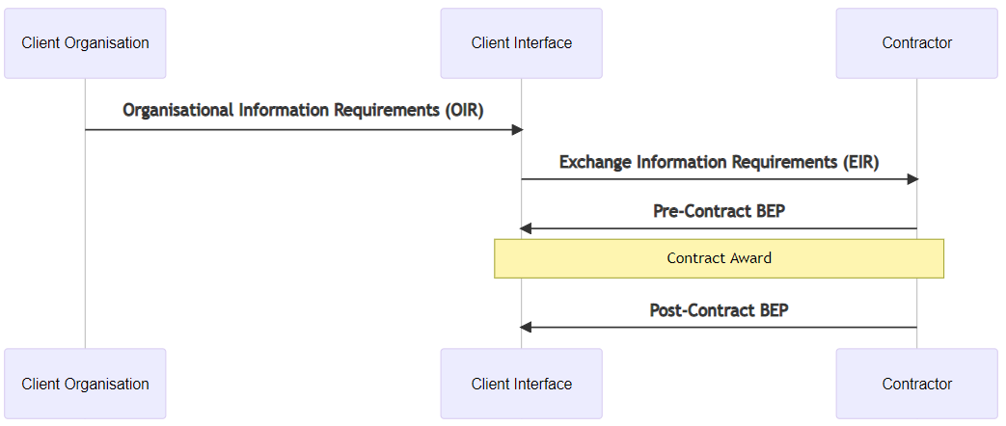
BEP - BIM Execution Plan

Slide 30
Key Terms – Task Information Delivery Plan (TIDP)
schedule of information containers and delivery dates, for a specific task team

Slide 31
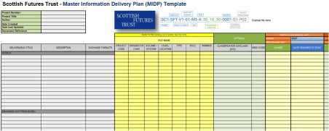
Key Terms – Master Information Delivery Plan (MIDP)
plan incorporating all relevant task information delivery plans

Slide 32
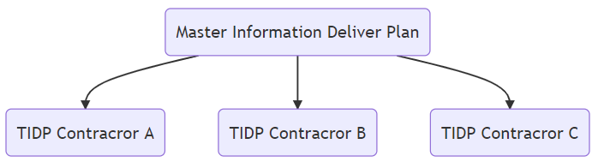
Relationship between MIDP & TIDP

Slide 33
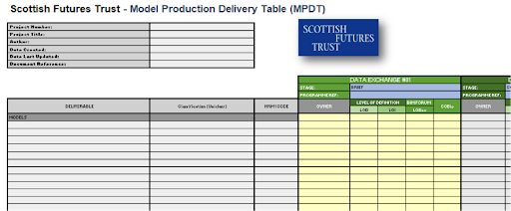
MPDT - Model Production Delivery Table
https://bimportal.scottishfuturestrust.org.uk/level2/stage/3/task/13/prepare-midp-raci-mp-dt

Slide 34
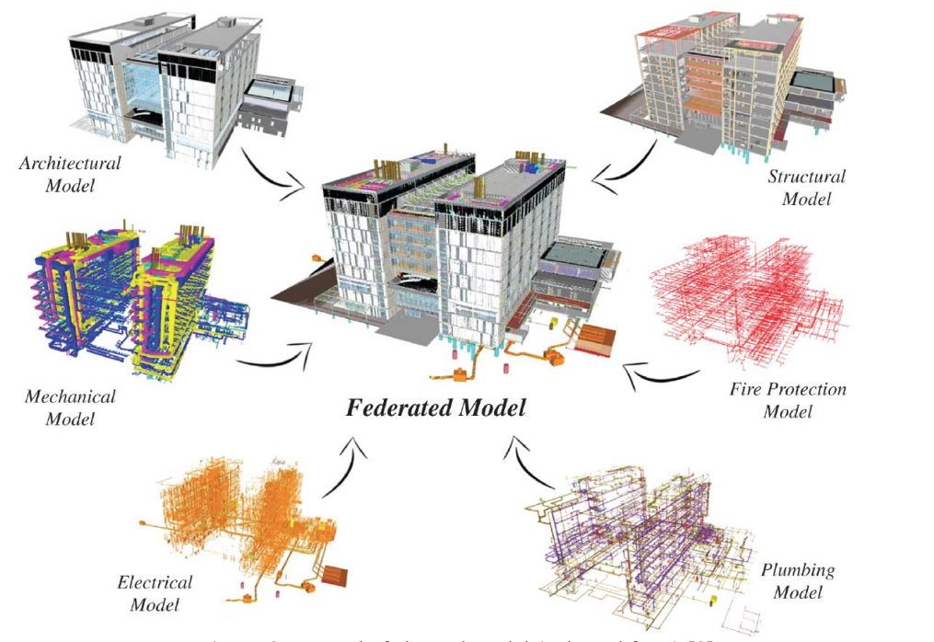
Federated Model
https://iopscience.iop.org/article/10.1088/1757-899X/869/2/022038/pdf

Slide 35

ISO 19650 — Part 2: Part 2: Delivery phase of the assets

Slide 36
Document Workflow

Slide 37
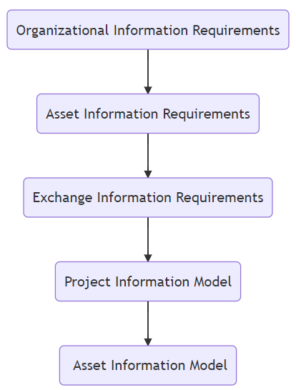
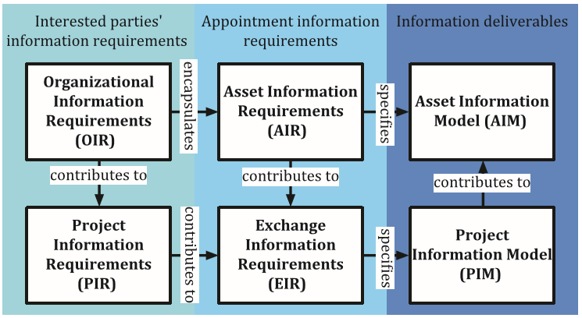
Project Delivery and Asset Management

Slide 38
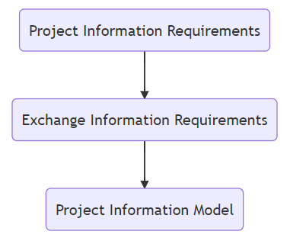
Project Delivery with no Asset Management

Slide 39
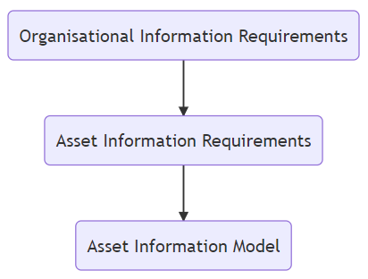
Asset Management with No Project Delivery

Slide 40
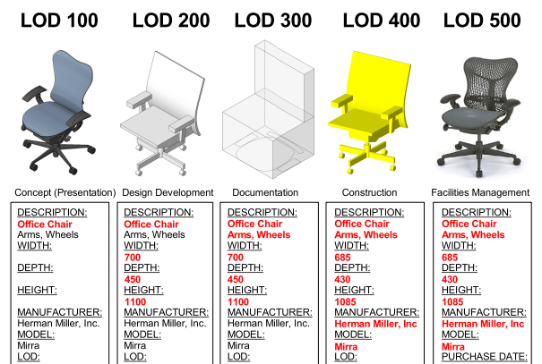
LOD: Level of Development

Slide 41
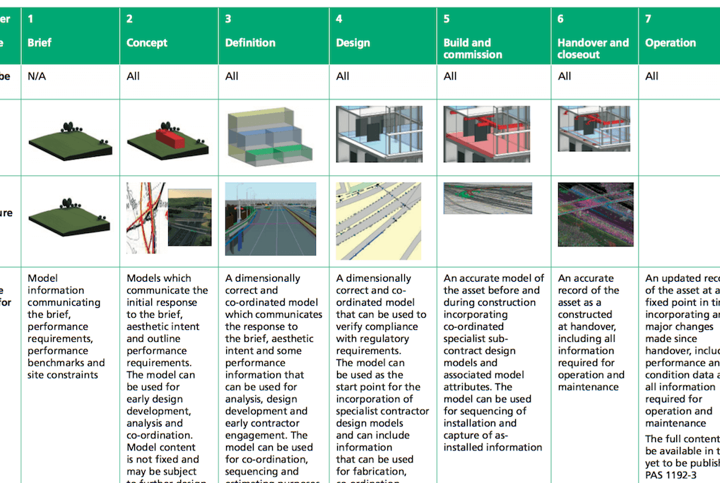
LOD: Level of Development

Slide 42
The LOD Problem
LOD has led to confusion, primarily due to the differing allocations for the ‘D’
Level of Development
Level of Detail
This has somewhat been cleared up by splitting into two alternative approaches
LOD – Level of Detail, focused on geometric information
LOI – Level of Information, focused on text-based data

Slide 43
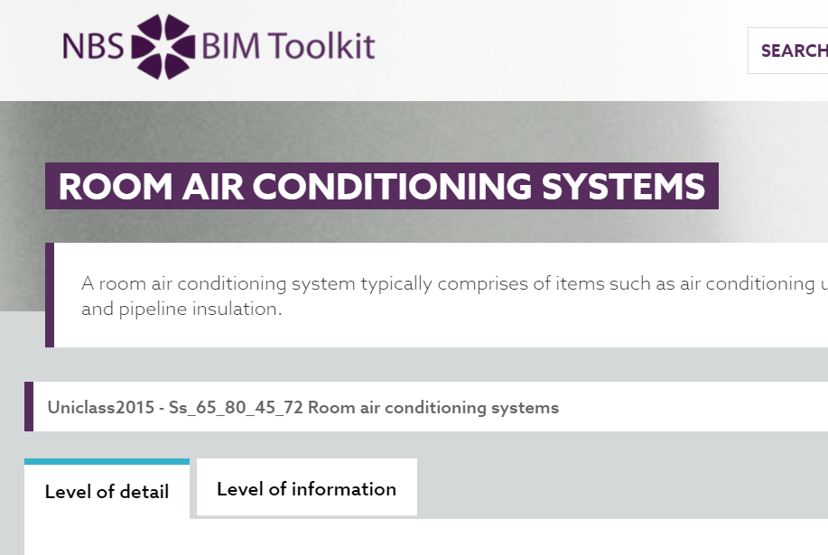
NBS – Level of Detail / Level of Information
Ref: https://toolkit.thenbs.com/definitions/Ss_65_80_45_72/

Slide 44
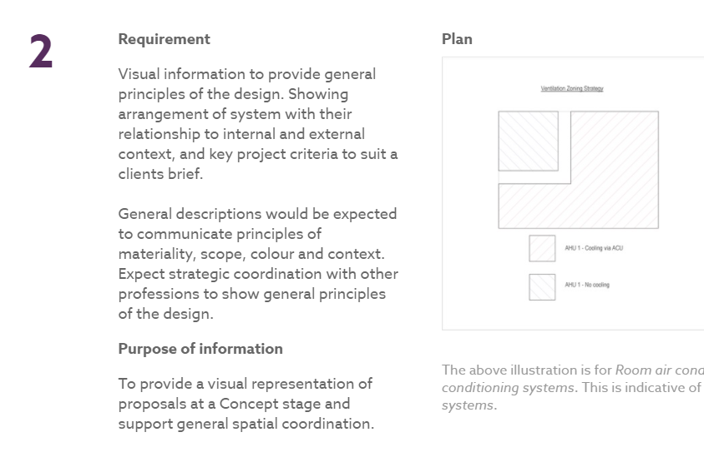
Level of Detail - 2

Slide 45
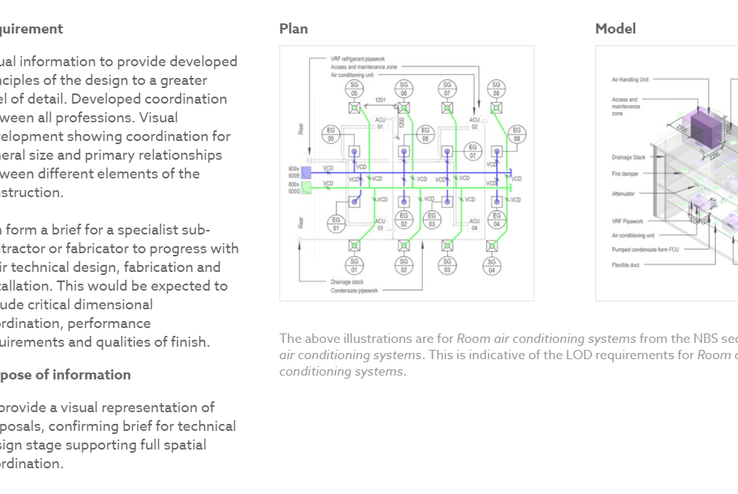
Level of Detail - 3

Slide 46
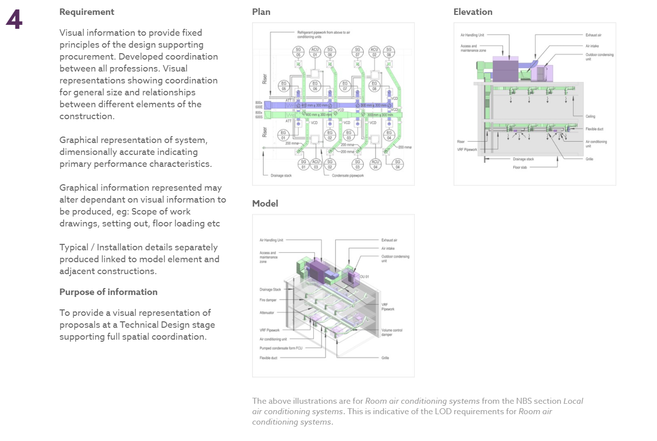
Level of Detail – 4

Slide 47
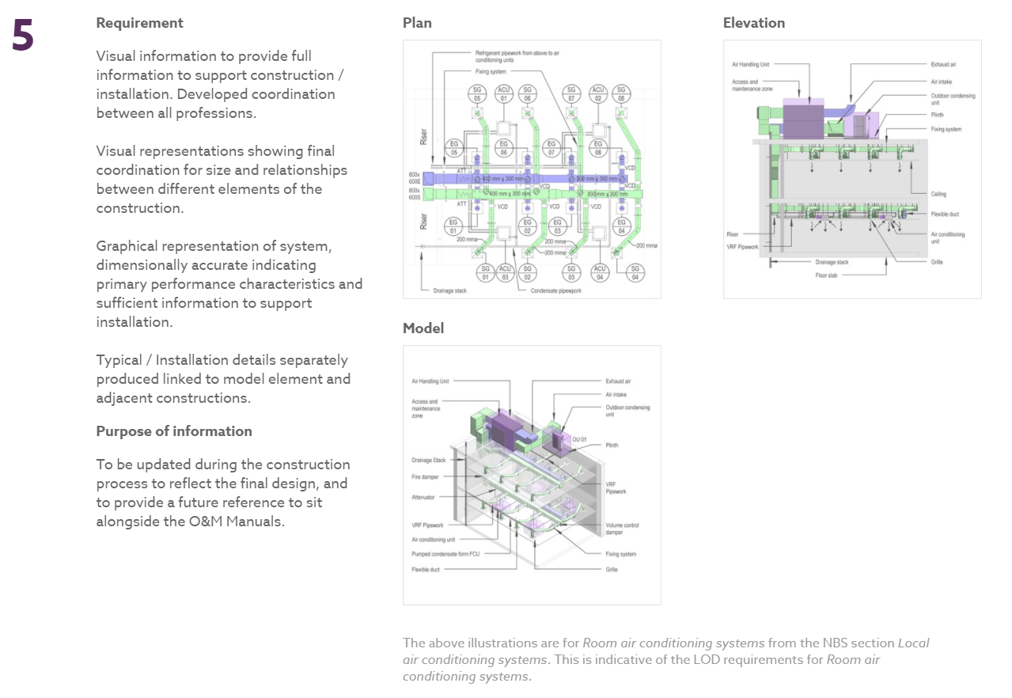
Level of Detail - 5

Slide 48

Level of Information – 2

Slide 49
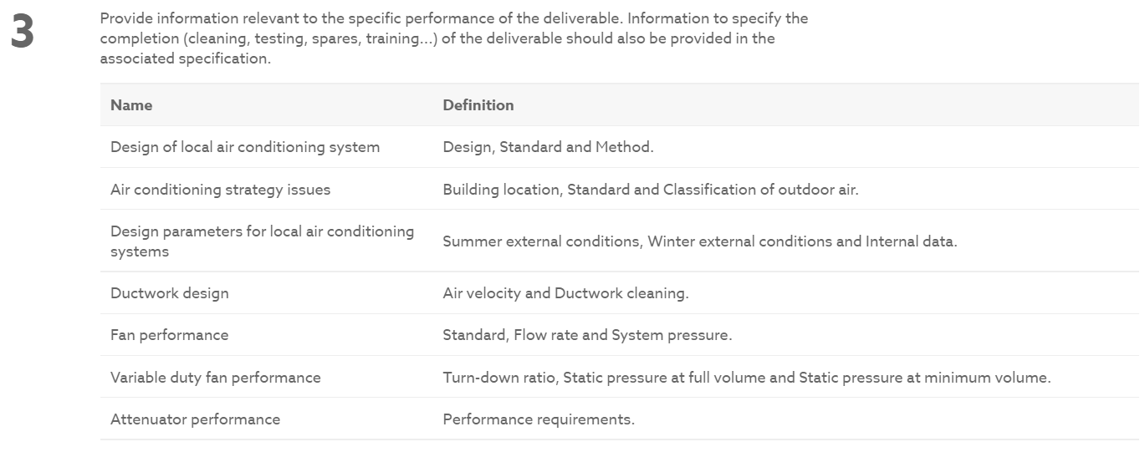
Level of Information – 3

Slide 50
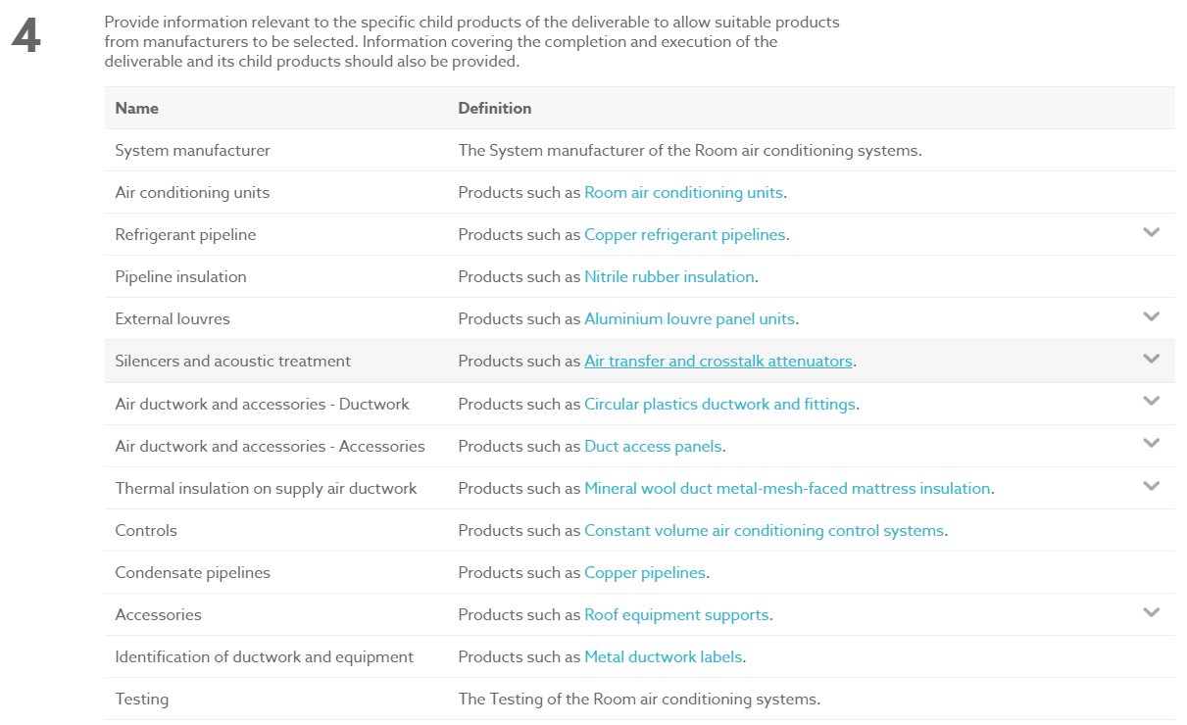
Level of Information – 4

Slide 51
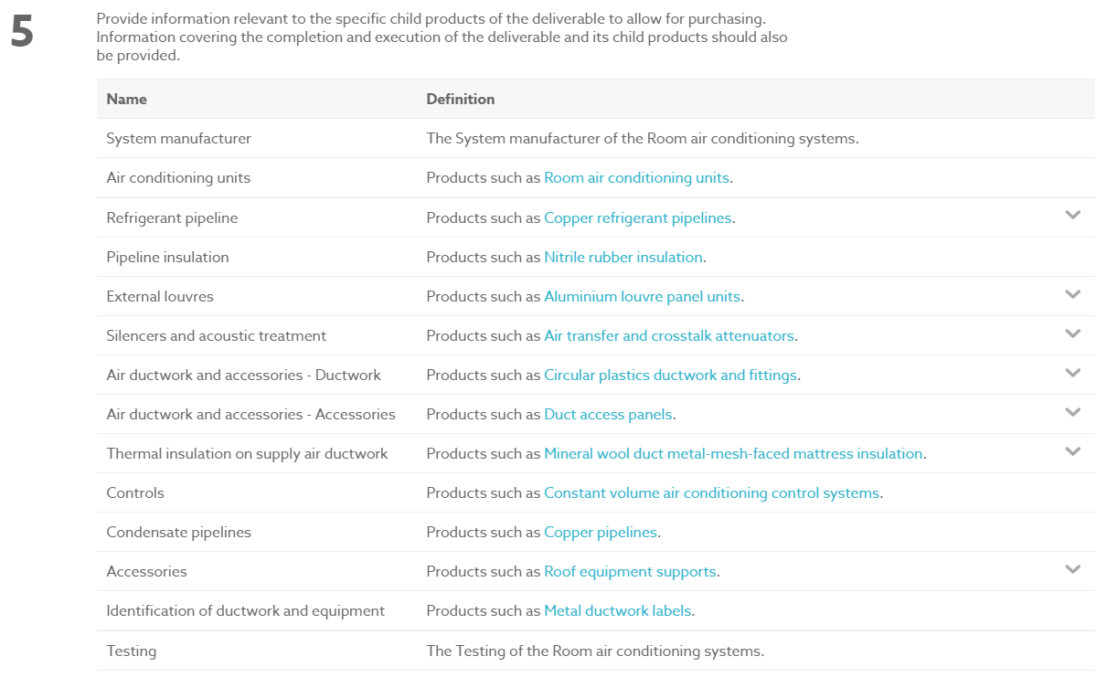
Level of Information – 5

Slide 52
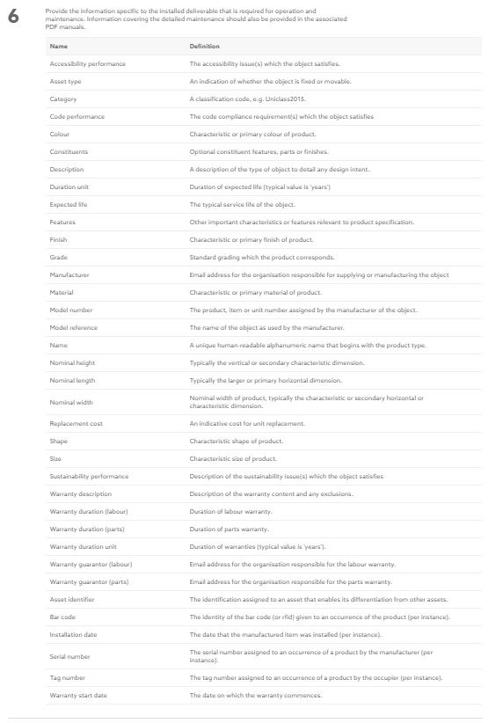
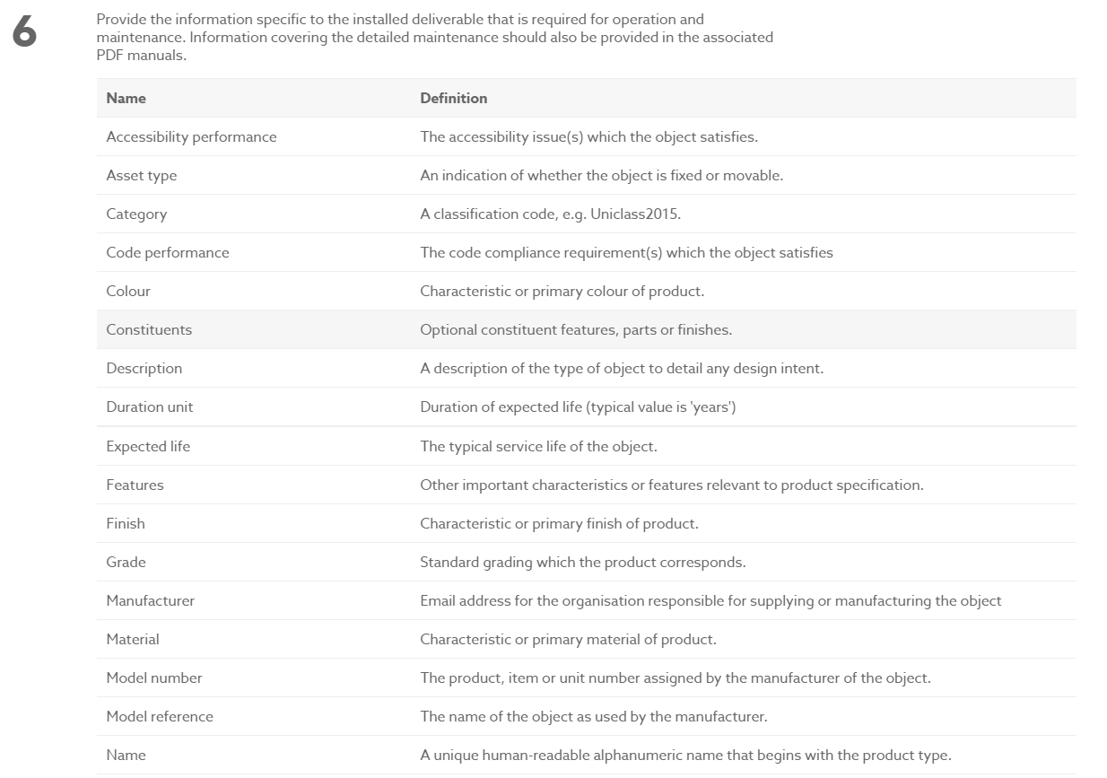
Level of Information – 6

Slide 53
BIM - ISO 19650 Implementation
Paul Vesey

Slide 54
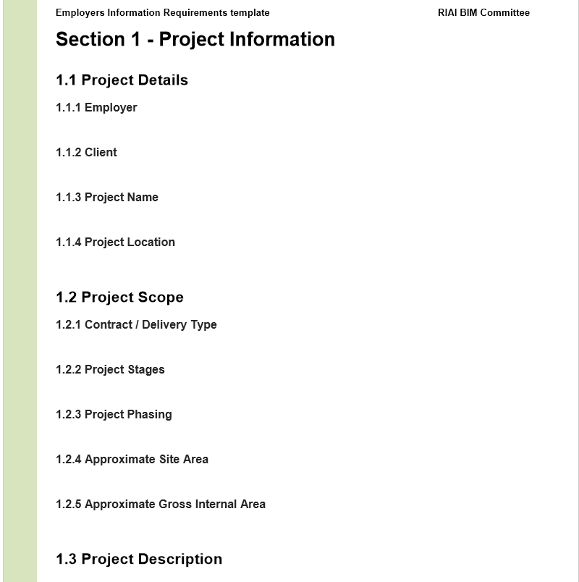
Pulling it all together – Organizational Information Requirements
RIAI - Employers Information Requirements Template Revision P1.2

Slide 55
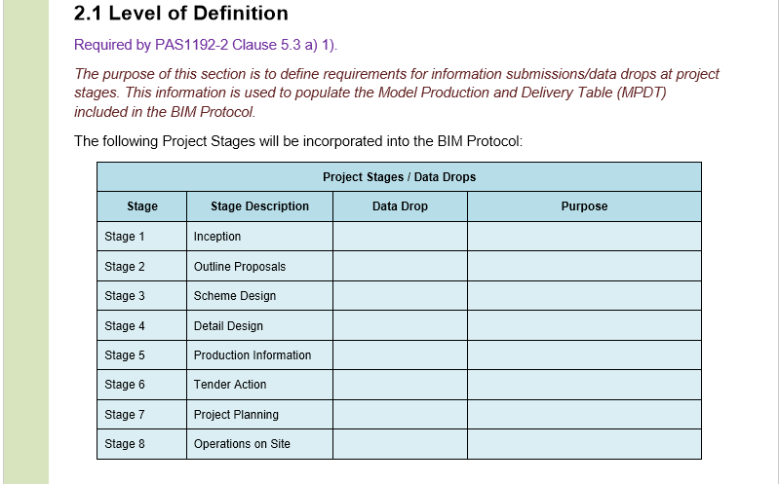
Pulling it all together – Organizational Information Requirements
RIAI - Employers Information Requirements Template Revision P1.2

Slide 56
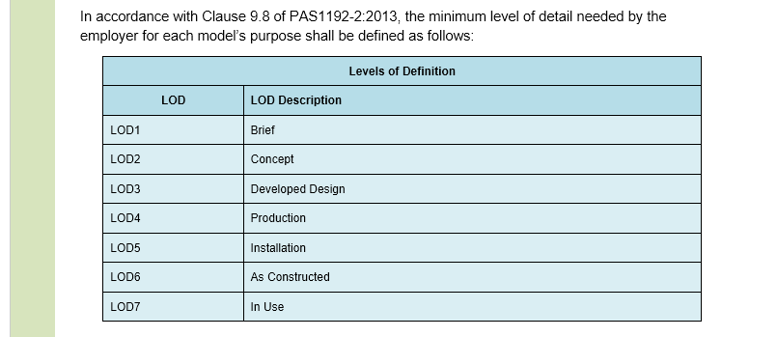
Pulling it all together – Organizational Information Requirements
RIAI - Employers Information Requirements Template Revision P1.2

Slide 57
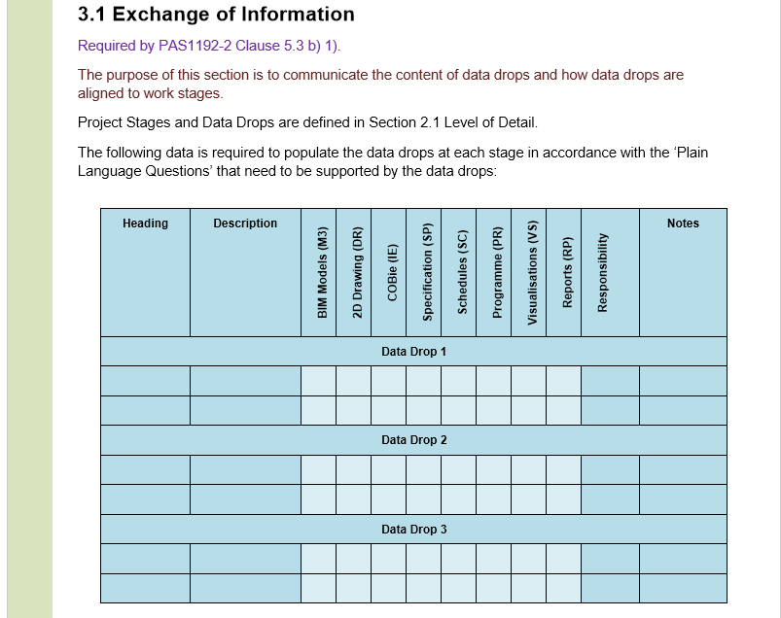
Pulling it all together – Organizational Information Requirements
RIAI - Employers Information Requirements Template Revision P1.2

Slide 58
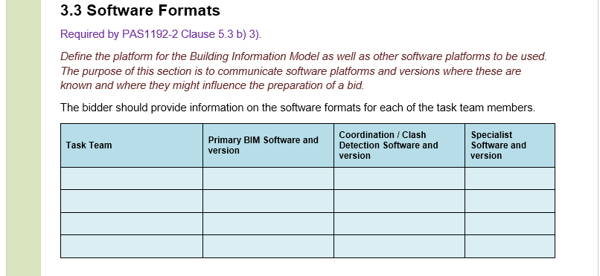
Pulling it all together – Organizational Information Requirements
RIAI - Employers Information Requirements Template Revision P1.2

Slide 59
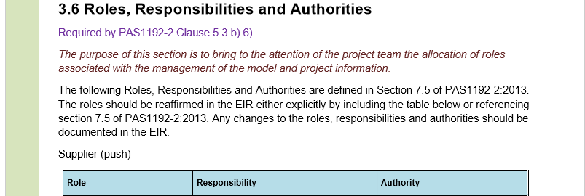
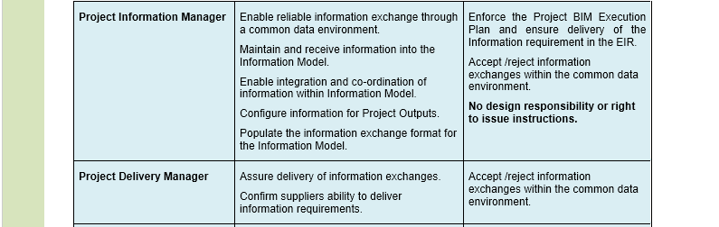
Pulling it all together – Organizational Information Requirements
RIAI - Employers Information Requirements Template Revision P1.2

Slide 60
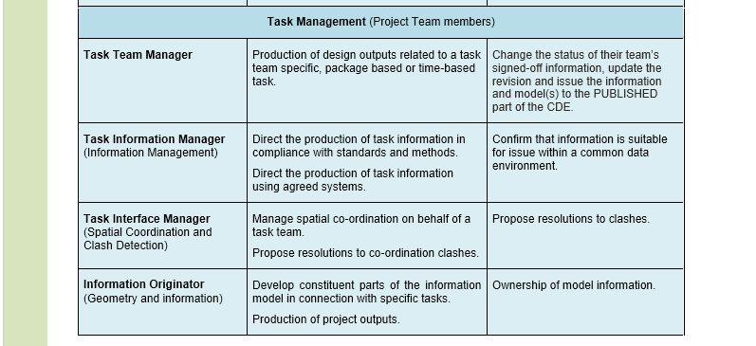
Pulling it all together – Organizational Information Requirements
RIAI - Employers Information Requirements Template Revision P1.2

Slide 61
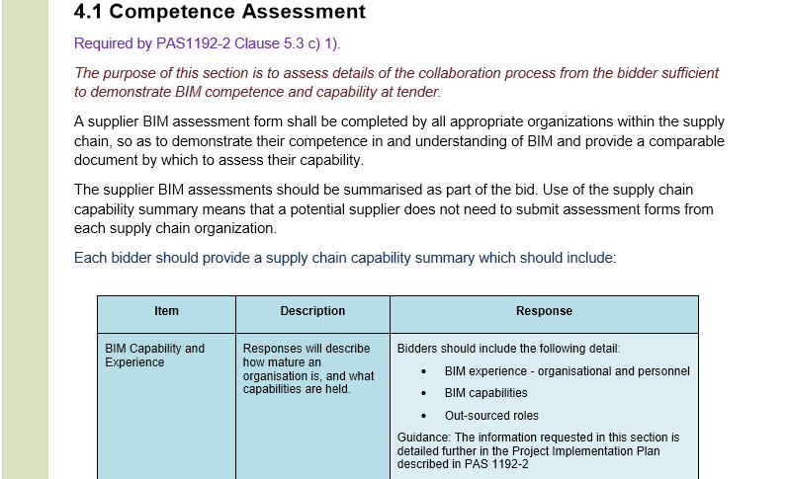
Pulling it all together – Organizational Information Requirements
RIAI - Employers Information Requirements Template Revision P1.2

Slide 62
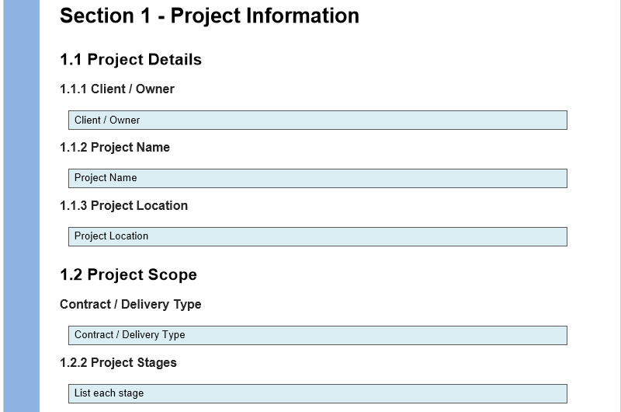
Pulling it all together – BIM Execution Plan
RIAI - BIM Execution Plan Template Revision P1.4

Slide 63
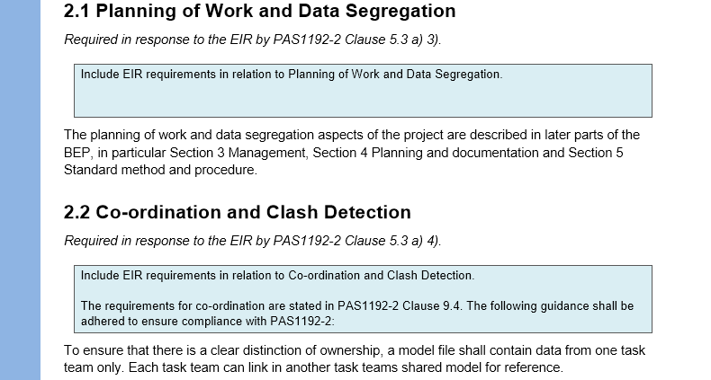
Pulling it all together – BIM Execution Plan
RIAI - BIM Execution Plan Template Revision P1.4

Slide 64
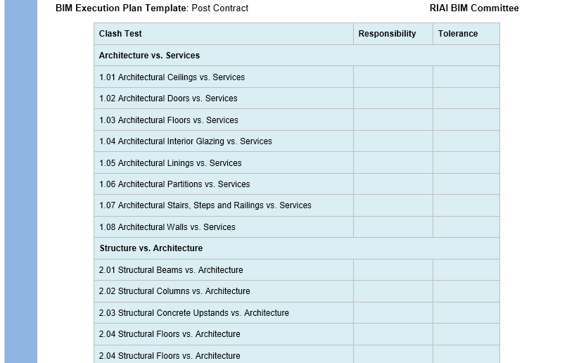
Pulling it all together – BIM Execution Plan
RIAI - BIM Execution Plan Template Revision P1.4

Slide 65
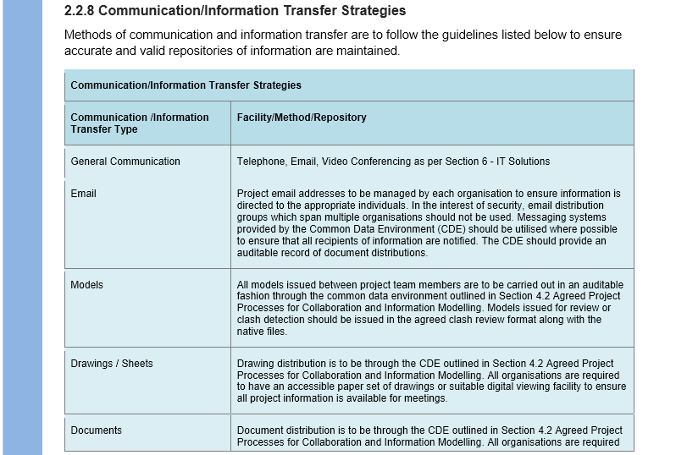
Pulling it all together – BIM Execution Plan
RIAI - BIM Execution Plan Template Revision P1.4

Slide 66
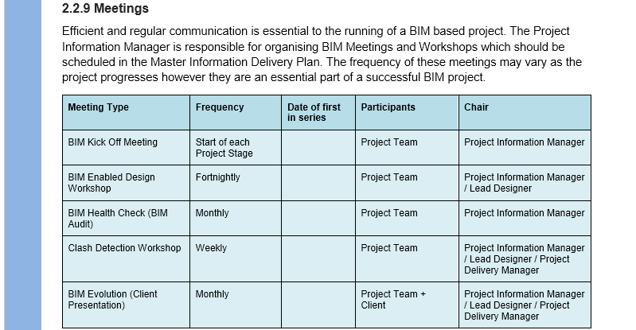
Pulling it all together – BIM Execution Plan
RIAI - BIM Execution Plan Template Revision P1.4

Slide 67

Pulling it all together – BIM Execution Plan
RIAI - BIM Execution Plan Template Revision P1.4

Slide 68

Pulling it all together – BIM Execution Plan
RIAI - BIM Execution Plan Template Revision P1.4

Slide 69

Pulling it all together – BIM Execution Plan
RIAI - BIM Execution Plan Template Revision P1.4

Slide 70

Pulling it all together – BIM Execution Plan
RIAI - BIM Execution Plan Template Revision P1.4

Slide 71

Pulling it all together – BIM Execution Plan
RIAI - BIM Execution Plan Template Revision P1.4

Slide 72

Pulling it all together – BIM Execution Plan
RIAI - BIM Execution Plan Template Revision P1.4

Slide 73
BIM - Process or Technology?
BIM is a Technology Enabled Process

Slide 74
BIM - ISO 19650 Overview and Implementation
Paul Vesey

